Slide 1
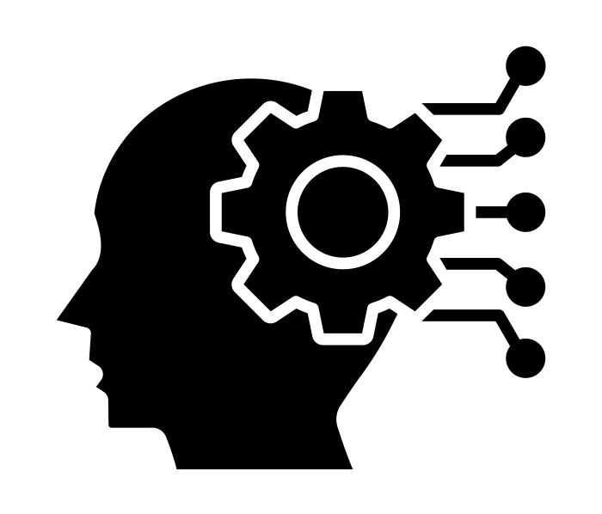
Explaining Kairos…
By: Hetav Patel

Slide 2
Overview.

Slide 3
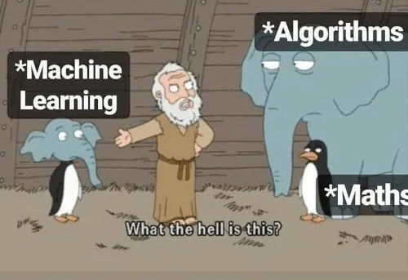
What is Kairos?
A cutting-edge Provenance-based Intrusion Detection System (PIDS).
Core Innovation: It utilizes a dynamic temporal graph neural network (encoder-decoder) to track structural changes in provenance graphs, identifying anomalies at the event level with high precision.
Key Outcomes: Generates concise attack summaries to help sysadmins quickly understand and respond to intrusions, outperforming existing systems on benchmark datasets.
Explainable AI
Temporal Graph Neural Networks
Kairos
Notes:
1st point:
Provenance Graphs: Provenance graphs are structured audit logs that describe the history of a system’s execution.
A cutting-edge Provenance-based Intrusion Detection System (PIDS) that addresses scope, attack agnosticity, timeliness, and attack reconstruction in detecting and analyzing host system intrusions.

Slide 4
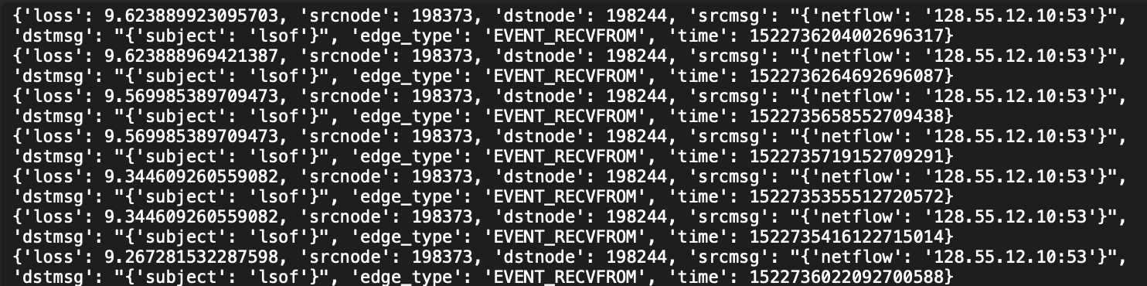
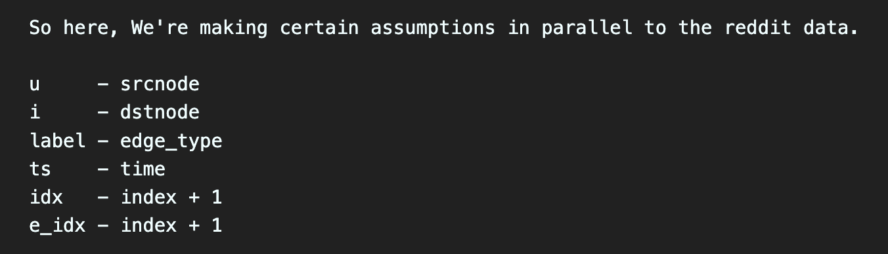
Sample Output from Kairos
Notes:
This is a sample log file for a particular date. This was the most essential part of the experiment and the future work that can be done on this project. This dataset is key in running and

Slide 5
Initial Setup.

Slide 6
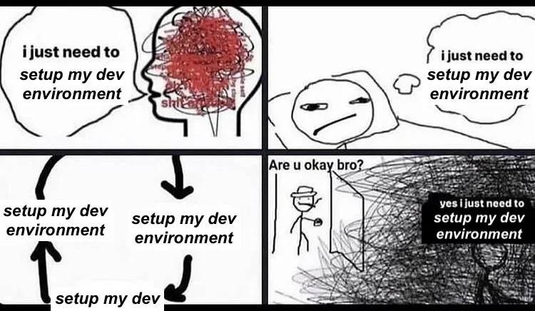
Environment!!!!
Notes:
Don’t even get me started on this. Running it on 5 different local machines and luckily 2 people, Ambika and Devang pulled it off by running it successfully.

Slide 7
We tried running the setup in 5 different systems with varying hardware capabilities and were successful in running the framework after almost 1.5 weeks.
I wasn’t able to run it in mine due to hardware restrictions on my system.
Nevertheless, this helped us in understanding what Kairos actually did and what the dataset and the model would look like, once preprocessed and ready for explanations.
Gave us an idea of what kind of preprocessing and feature engineering needs to be done to fit it to the XAI models we tried.

Slide 8
Research Questions (RQs)

Slide 9
There were 3 main research questions that we tackled:
How do explanation models studied in the course (and potentially beyond) fail in handling temporal datasets for security applications?
How do the limitations in feature correlations affect security decisions like malware detection?
What are the human-centric usability issues with current XAI models when used in security contexts?
Notes:
I mainly worked on the first research question and also worked on trying to build an evaluation framework with multiple XAI models that could work on temporal graph datasets.

Slide 10
Comprehensive Evaluation Framework

Slide 11
Survey:
A thorough survey was conducted to understand what research has already been done in this field.
Some of the papers we found:
[Proceedings of the IEEE 24] Trustworthy Graph Neural Networks: Aspects, Methods and Trends
[Preprint 24] Graph-Based Explainable AI: A Comprehensive Survey
[Arxiv 23] A Survey on Explainability of Graph Neural Networks
[ACM computing survey] A Survey on Graph Counterfactual Explanations: Definitions, Methods, Evaluation, and Research Challenges
[TPAMI 22]Explainability in graph neural networks: A taxonomic survey. Yuan Hao, Yu Haiyang, Gui Shurui, Ji Shuiwang.
[Arxiv 22]A Survey of Explainable Graph Neural Networks: Taxonomy and Evaluation Metrics paper
[Arxiv 22] A Survey of Trustworthy Graph Learning: Reliability, Explainability, and Privacy Protection
[Big Data 2022]A Survey of Explainable Graph Neural Networks for Cyber Malware Analysis
[Arxiv 23] A Comprehensive Survey on Trustworthy Graph Neural Networks: Privacy, Robustness, Fairness, and Explainability
[Arxiv 22] Explaining the Explainers in Graph Neural Networks: a Comparative Study
[Book 23] Generative Explanation for Graph Neural Network: Methods and Evaluation
Notes:
Raghu and I spent most of out time trying to find important research papers that could give us a starting point to work with these model. These were some of the papers that we found interesting. Funny enough, novel research was very little in these papers. Most of them were surveys and SoK papers. Interestingly we found two papers worth spending time on.

Slide 12
The Base Papers:
Self-Explainable Temporal Graph Networks based on Graph Information Bottleneck (ArXiv) [TGIB]
An Explainer for Temporal Graph Neural Networks (ArXiv) [TGNN]

Slide 13
TGIB Framework:
Inherently explainable model that works on introducing stochasticity in Information Bottleneck Theory.
It provides explanations as comparisons with other papers as the difference in timestamps.
Far more superior than other Graph Explainers.
Developed on top of the research done in TGNN.
Codebase and dataset is pretty identical.
Not peer-reviewed as it was released recently. (Aug ‘24)
Notes:
Code didn’t work properly. Tried for a week before giving up. This could be potential future work in this project. It is an interesting model with a very different working than the normal as it’s an inherently explainable model.
IB Theory is designed for finding the best tradeoff between accuracy and complexity (compression) when summarizing (e.g. clustering) a random variable X, given a joint probability distribution p(X,Y) between X and an observed relevant variable Y.
In temporal graphs, events that occurred recently should have a greater influence on the target event compared to events that happened a long time ago; however, GNNExplainer and PGExplainer fail to capture this.
Additionally, we marked the difference in occurrence timestamps between the target event and each of the five explanation events. Then, the mean time intervals are calculated as follows: (a) 1228523.4, (b) 1475006.2, and (c) 612333.2. This shows that the time interval for (c) is smaller than that for (a) and (b), and that the timestamps of the explanation events in TGIB are closer to the timestamps of the target events. than those in GNNExplainer and PGExplainer.

Slide 14
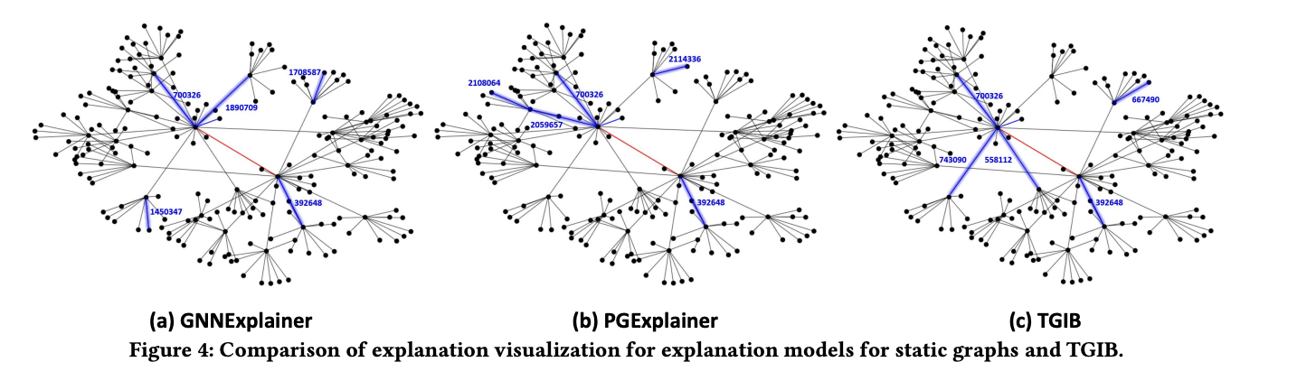
Notes:
This is not what the graph outputs, it’s just a way of explaining how the difference in timestamps is less in TGIB than the other models run on the same dataset.

Slide 15
TGNN Framework:
First model to explain dynamic temporal graphs
Experimental results demonstrate that T-GNNExplainer can achieve superior performance with up to 50% improvement in Area under Fidelity-Sparsity Curve compared to other explainers.
Task Objective: Find a subset of historical events that lead to a temporal prediction.
Problem Solution: T-GNNExplainer uses Monte Carlo Tree Search (MCTS) to explore event subsets and a navigator to learn correlations between events.
Combinatorial Optimization: Handles the combinatorial optimization problem of finding the optimal event subset.
Notes:
Code works!
Extensive documentation on running the code is available.
Possible Future Work: If possible, trying to integrate TGIB into the Kairos base model seamlessly to create an inherently explainable model that could be an Intrusion Detection System and an explainable model both.

Slide 16
What did I do and learn?

Slide 17
What I did:
Assumed lead in developing the comprehensive evaluation framework.
Aided in preprocessing the output log data from Kairos to make it compatible with the TGNN Framework.
This involved making many assumptions with the data and preprocessing the data accordingly and applying feature engineering.
Worked on getting TGIB to run so that a cybersecurity dataset can tried on the framework.
Furthermore, found compatible research papers and previous work to give us a starting point.
Lent a hand in getting Kairos to work.
The github commits made by me and my teammates can be seen here.
Notes:
(Code didn’t work in the end) for TGIB.

Slide 18
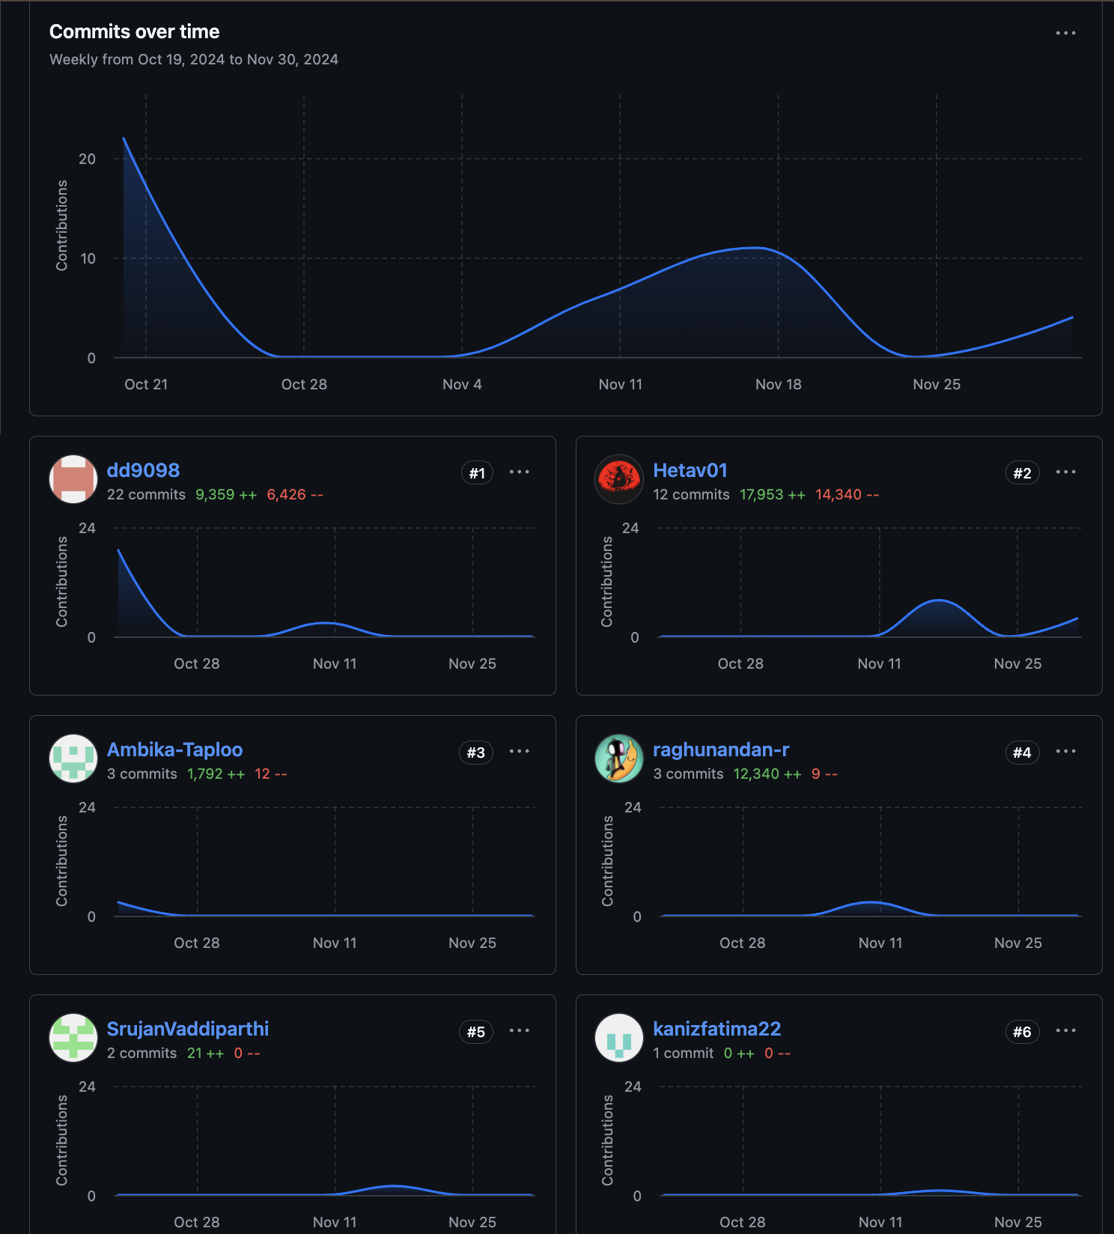

Slide 19
What I learnt:
“You learn more on the job than before.”
Graph Neural Networks and new types of Explainability.
Environment setup is a nightmare!!
Teamwork!
Reviewed a ton of literature relating to XAI.
Notes:
Firstly, I’d like to thank all my teammates and congratulate and applaud them on the work they did in this project. It was a new experience and field for almost all of us and I think even if we were not able to successfully complete all the tasks or contribute something really novel, we did manage to put forth something valuable.
Rightly so, I never had experience working with Graph Neural Networks or Deep Learning in so much depth, it was a fulfilling challenge to try and understand the complex code and trying to break it down to understand it fundamentally.
I’m so well versed in environment setup now after doing it over and over in this project :).
Literature was the thing that helped me the most. Reviewing papers quickly is a skill I think is valuable for me as a graduate student.

Slide 20
Thank You

